Slide 1
Team 4 What’s your personality ?
New Recording
00 : 00
Submit

Slide 2
Team 4 What’s your personality ?
New Recording
00 : 01
Submit

Slide 3
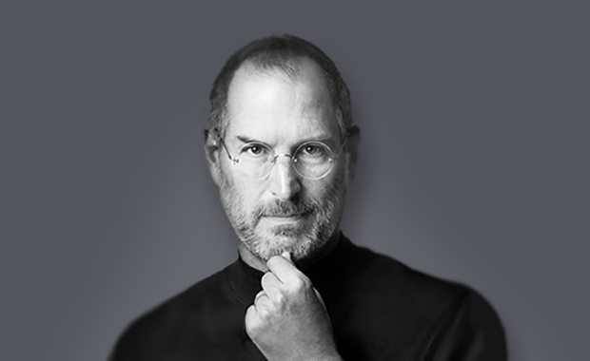
Team 4 What’s your personality ?
Steve Jobs
Taylor Swift
Megan Fox
Dr. Dre
- Entrepreneur
- Strong leadership
- Highly self motivation
- Competitive spirit
Intense focus
High self-confidence
Assertive

